Slide 1
Tools and Frameworks
Tools & Frameworks
GPU Driver Installation & Troubleshooting
Docker Setup & Usage
Python Libraries & Utilities
Linux Commands & Automation

Slide 2
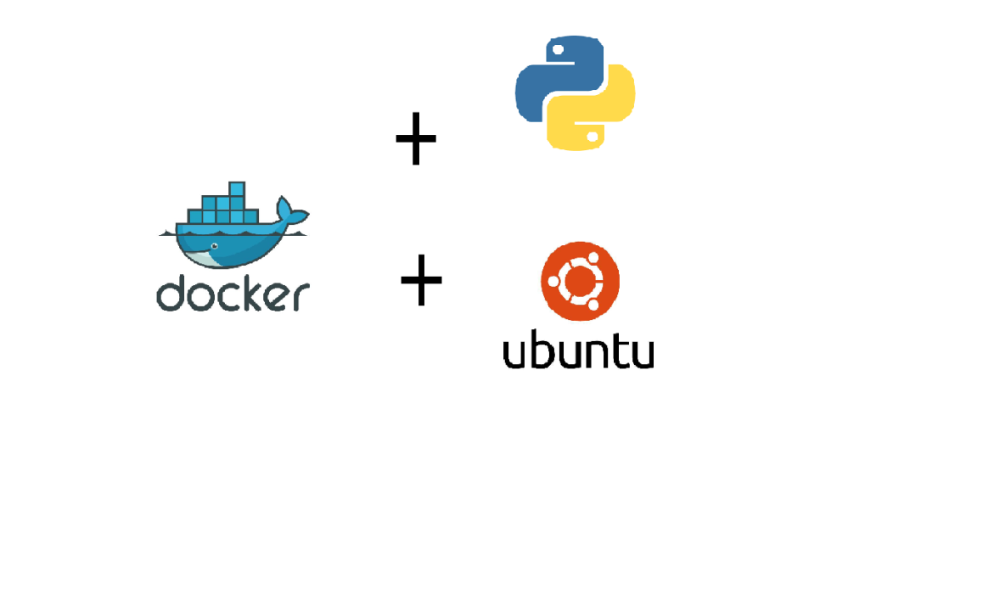
1. Understanding the Tools & Frameworks
Overview:
Linux (Ubuntu): Used for deploying models in a stable server environment.
Docker: Provides containerization to ensure a consistent runtime.
Python: Core programming language for training and deploying models.

Slide 3
2. GPU Driver Installation & Troubleshooting
Setup instructions assumes you are working with Ubuntu, though if you are working with any other linux based system the instructions are pretty much the same just the package manager name like “apt” will change to “yum” etc.
GPU Driver installation
sudo apt update
sudo apt-cache show nvidia-driver*
sudo apt install nvidia-driver-XXX
sudo reboot
nvidia-smi

Slide 4
Troubleshooting nvidia driver
Sometimes you might encounter an error if you run ‘nvidia-smi’ command in the cli called version mismatch.
“NVML: Driver/library version mismatch”
This might happened because the driver installed might not be compatible with the hardware present.
To make sure the hardware and driver are compatible the most reliable approach is to follow this https://download.nvidia.com/XFree86/Linux-x86_64/
Here Linux-x86_64 is for type of CPU processor architecture (64 bit x86) and Linux is for any linux based OS like Ubuntu, Debian etc.

Slide 5
Troubleshooting nvidia driver (Cont.)
Select the driver version of your choice for e.g. 535.104.05 in this case.
https://download.nvidia.com/XFree86/Linux-x86_64/535.104.05/README/supportedchips.html
If your graphics card is present in the list that means the driver is correct otherwise you will have to find the driver version in which the list contains the graphics card of your choice.

Slide 6
Setup (Continued)
Docker installation
Installation page here.
Post installation steps here.
Docker Nvidia support
In order to access GPU inside a docker image you need to install nvidia-docker as well on the system after installing docker and nvidia driver.
The steps to be followed are in this link.
Offline setup step are here.
Change default docker service storage location here.

Slide 7
Docker helpful commands
docker ps (Lists running docker processes)
docker stop <ContainerId> (Stops a containerid)
docker logs <ContainerId> (view logs of a running container)
docker run -it imagename bash (step into a dockerimage to debug)
Lets Breakdown our finetuning command.
docker run -it --rm -v /home/ubuntu/pix2struct-vqa-dummy-data/edc_dummy_data:/usr/src/data -e MAX_PATCHES=3072 -e MAX_LENGTH=256 -e NUM_EPOCHS=5 --gpus all --ipc=host neuralspaceacr.azurecr.io/hrsd/ns-hrsd-qna:v1 python dist/finetune.py
-it (interactive)
–rm (once the job completes delete the running container so that it does not give an error on running again)
-v (mounts a local directory to docker directory)
-e (Environment variables which are used for training)
–gpus all (provides access to all gpus inside the docker image)
–ipc=host (inter process communication in docker image uses hosts namespace)

Slide 8
Python tools and libraries
Libraries
PyTorch (Model training)
FastAPI (For server)
PIL (Image processing)
Python relevant files
server.py
convert_certificates.py (excel to json)
batch_inference.py
calc_accuracy.py

Slide 9
Helpful Linux commands
htop (displays resource usage of CPU and RAM of the system)
watch -n 0.5 ‘nvidia-smi’ (runs nvidia-smi command every 0.5 seconds)
ls -lrth (lists all the files and directories and sorts them based on modification time)
cat /etc/os-release (displays OS details)
lscpu (displays CPU details)
ls hw (list hardware details)
ifconfig (displays network details)
systemctl status docker (status of docker service)
systemctl stop docker (stops docker service)
systemctl start docker (starts docker service)
systemctl enable docker (automatically start docker service on system boot)

Slide 10
Additional steps
Automatically mount volumes on startup of the OS.
For mounting disks this link is quite general and applicable for most linux system.
Run docker service automatically after reboot
Adding ‘-dt --restart unless-stopped’ will run the docker command in a daemon mode (background) and it will always start when the docker service starts unless stopped externally.

Slide 11
Next Session topic
In-depth model training guide
Fine-tuning script overview
Data formatting and validation
Data balancing
GPU monitoring and Resource optimization
Expectations from the pretrained model

